Slide 1

NewsRankAI
Agrima Gupte - 23107044
Durvesh Wagle - 23107019
Ahan Upadhye - 23107027
Riddhi Pise - 23107087
Project Guide
Mr. Ujwala Pagare

Slide 2
Sustainable Development Goals (SDG)Mapped
SDG 4 – Quality Education
The project promotes learning and research in fields like AI, machine learning, and natural language processing.
It helps students understand how technology can be used to analyze textual data.
The system can be used as an educational tool for studying news trends and categories.
It supports the development of technical skills and knowledge in data analysis and AI.

Slide 3
Sustainable Development Goals (SDG)Mapped
SDG 4 – Industry, Innovation and Infrastructure
The project uses artificial intelligence and machine learning to build an innovative digital system.
It helps automate the process of organizing and classifying large amounts of news data.
The system improves digital infrastructure by providing a smart web-based news analysis platform.
It encourages the use of modern technologies for developing intelligent information systems.

Slide 4
Introduction
NewsRankAI is a web application that uses machine learning to classify news headlines into categories like politics, sports, business, and technology.
Users can enter a news headline and the system automatically predicts its category.
The project also includes a dashboard and history section to view analytics and previous predictions.
It helps organize news content efficiently and makes it easier to understand large amounts of news data.

Slide 5
Introduction
Objectives:-
1.News Article Data Collection and Preprocessing
Collect news articles from datasets or APIs.
Convert text data into numerical features using techniques like TF-IDF or word embeddings.
2.Automatic News Categorization
Train a machine learning classifier such as NLP, Logistic Regression, or Support Vector Machine
Evaluate the model performance using metrics such as accuracy, precision, recall, and F1-score.
Classify news articles into categories like Politics, Sports, Business, and Technology.

Slide 6
Introduction
Objectives:-
3. News Article Ranking Mechanism
Rank articles within each category based on relevance.
Use features such as keyword frequency, article length, recency, or popularity score.
4. User-Friendly Output and Visualization
Display categorized and ranked news articles in an easy-to-understand format.
Show category-wise top-N news articles.
Provide simple visual insights such as bar charts for categories or ranked list views.

Slide 7
Literature Survey of the existing system
Sr. No. | Title | Author(s) | Year | Outcomes | Methodology | Result
1. | News Classification Using Machine Learning | Kowsari, Jafari Meimandi, Heidarysafa | 2019 | Automated classifications of news articles into predefined categories. | Used machine learning algorithms like Naive Bayes and SVM for text classification of news articles. | The study showed that machine learning models can accurately classify news content with high efficiency.
2. | Text Classification Algorithms: | Aggarwal & Zhai | 2025 | Provided a comprehensive overview of text classification techniques. | Surveyed different machine learning methods such as decision trees, SVM, and neural networks for text classification. | Concluded that machine learning methods significantly improve text classification accuracy.

Slide 8
Literature Survey of the existing system
Sr. No. | Title | Author(s) | Year | Outcomes | Methodology | Result
3. | News Article Classification Using Natural Language Processing. | Zhang, Zhao & LeCun | 2024 | Improved accuracy in categorizing news articles automatically. | Used deep learning and NLP techniques for text classification of news datasets. | Deep learning models achieved better performance compared to traditional methods.

Slide 9
Limitations of existing systems
From the literature review of existing systems, we find that:
Traditional models require large labeled datasets which are difficult to collect.
Some methods show lower accuracy when classifying short or unclear news headlines.
Many systems cannot fully understand the context or meaning of complex text.
Deep learning based systems may require high computational power and longer training time.

Slide 10
Problem statement
Existing systems often struggle to accurately classify news headlines because of limited understanding of context and variations in text.
There is a need for a system that can automatically and efficiently categorize news into appropriate topics to manage large amounts of news data.

Slide 11
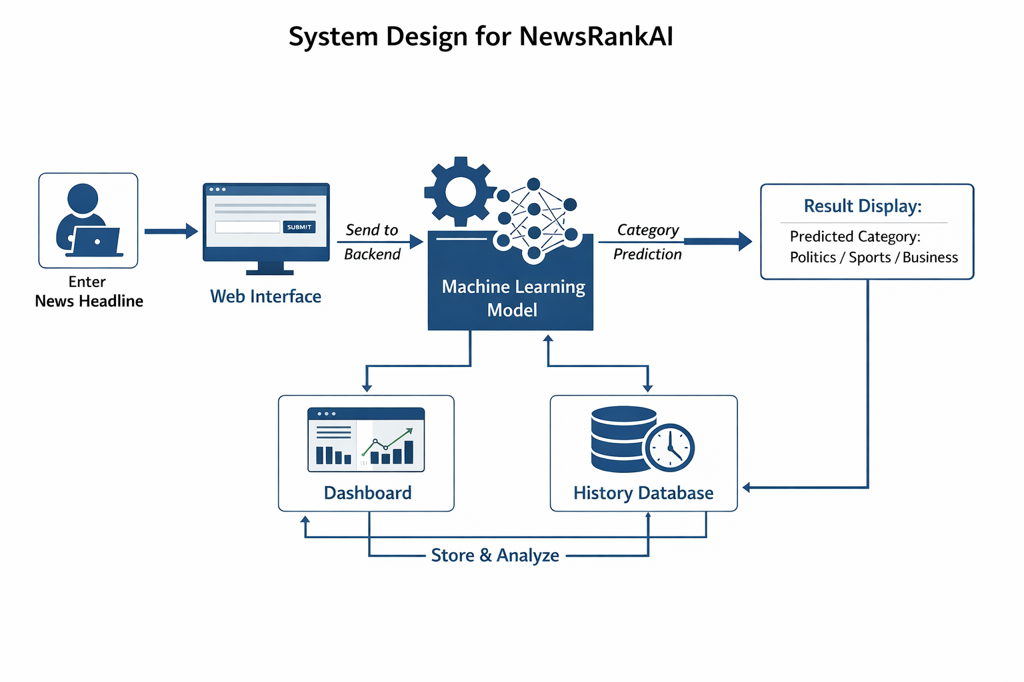
System Design

Slide 12
Technologies and methodologies
Technologies:
1. Frontend (User Interface)
HTML and CSS are used to design the user interface of the web application.
JavaScript is used to make the pages interactive and dynamic.
Chart.js is used to display charts and analytics on the dashboard.
2. Backend (Logic & Processing)
Python is used for building the backend logic of the application.
Flask framework is used to handle requests and connect the frontend with the machine learning model.
A database is used to store prediction history and user data.

Slide 13
Technologies and methodologies
Technologies:
3.AI & ML Models (The Core)
Natural Language Processing (NLP) techniques are used to preprocess and analyze the news text, such as tokenization, stop-word removal, and text cleaning.
The processed text is converted into numerical form using methods like TF-IDF so that machine learning models can understand the data.
Logistic Regression is then used as the classification model to predict the news category with good accuracy and precision.

Slide 14
Technologies and methodologies
Methodologies:
Collect and preprocess the news dataset using NLP techniques such as text cleaning, tokenization, and removal of stop words.
Convert the processed text into numerical features using techniques like TF-IDF for machine learning processing.
Train a machine learning model such as Logistic Regression to classify news headlines into different categories.
Evaluate the model and use it in the web application to predict the category of new news headlines.

Slide 15
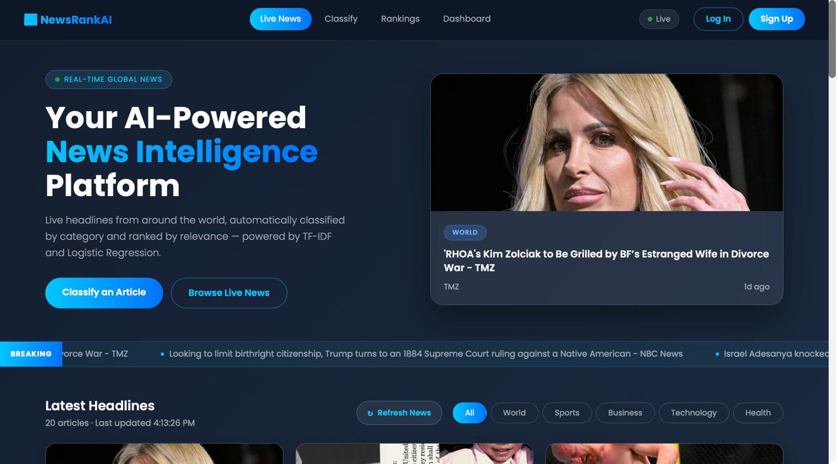
Implementation

Slide 16
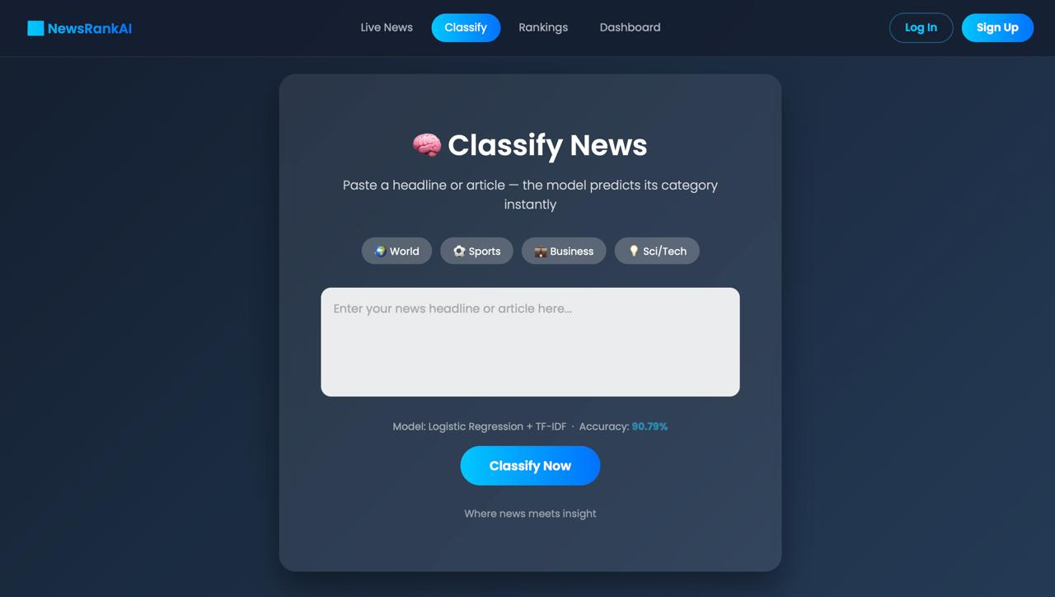
Implementation

Slide 17
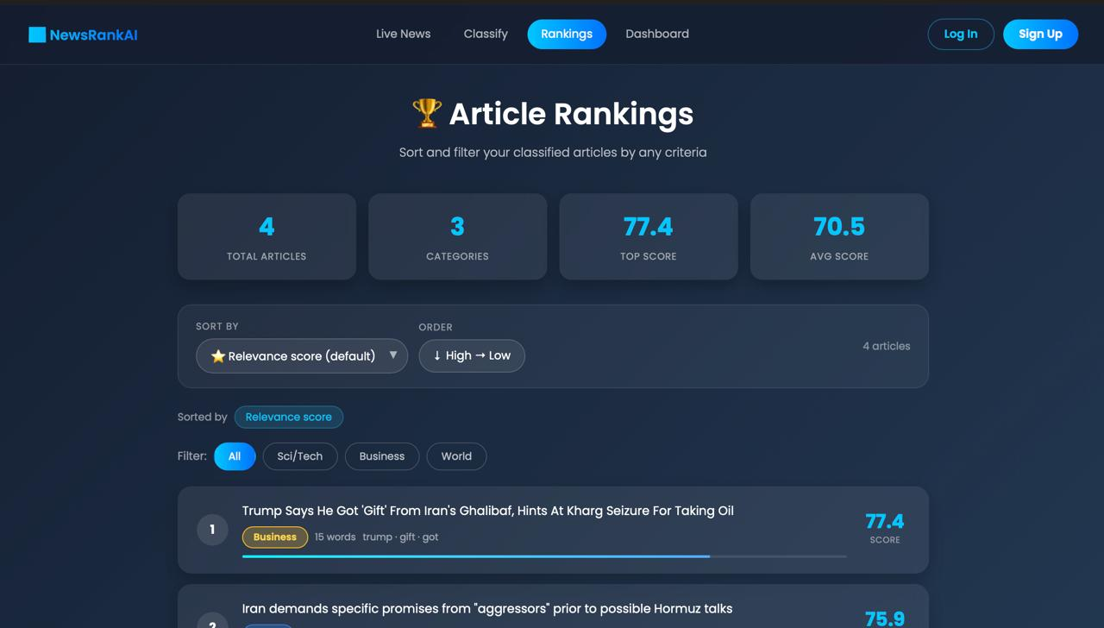
Implementation

Slide 18
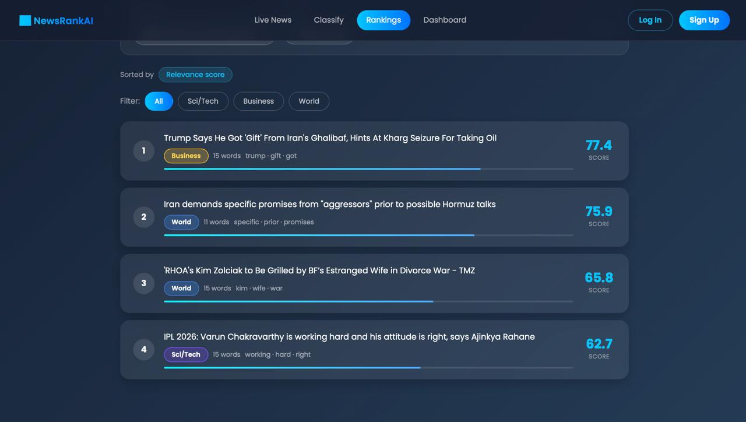
Implementation

Slide 19
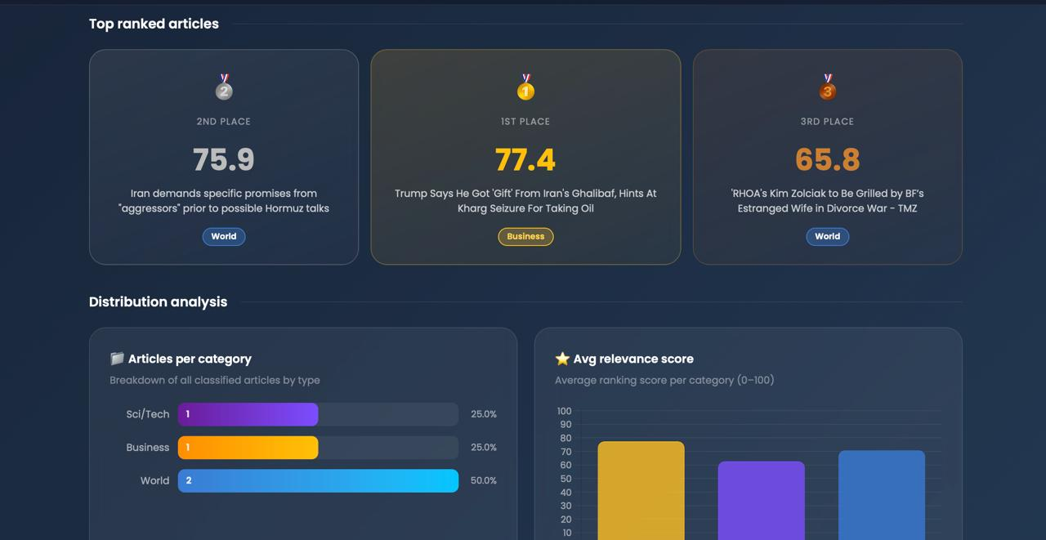
Implementation

Slide 20
Conclusion
The NewsRankAI system demonstrates how machine learning and natural language processing can be used to automatically classify news headlines into different categories. The system helps in organizing and analyzing large amounts of news data efficiently. By using models like Logistic Regression with NLP techniques, the application can accurately predict the category of a given news headline. This project shows the potential of AI-based systems in improving news management and information analysis.

Slide 21
References
[1] Kowsari, K., Jafari Meimandi, K., Heidarysafa, M. “Text Classification Algorithms: A Survey.”
[2] Aggarwal, C. C., Zhai, C. “A Survey of Text Classification Algorithms.”
[3] Zhang, X., Zhao, J., LeCun, Y. “Character-level Convolutional Networks for Text Classification.”
[4] Sebastiani, F. “Machine Learning in Automated Text Categorization.

Slide 22
Thank You...!!

